Slide 1
Java SE Developer 1z0-819
講師:江聖榮

Slide 2
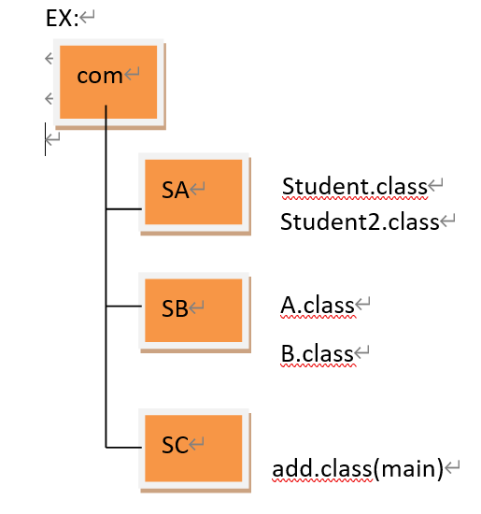
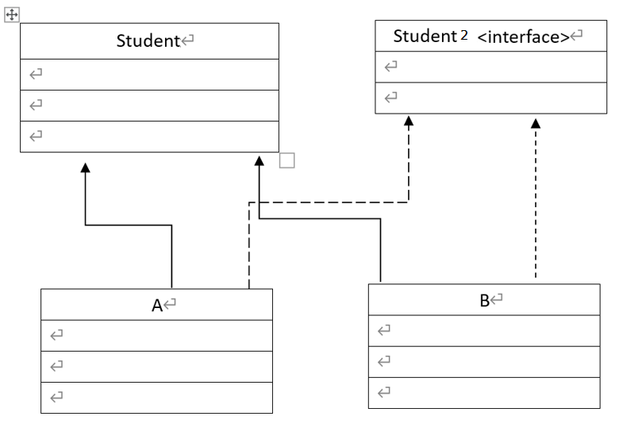
package,encapsulation
Package
import
Encapsulation
Public
Protected
<default>
private

Slide 3
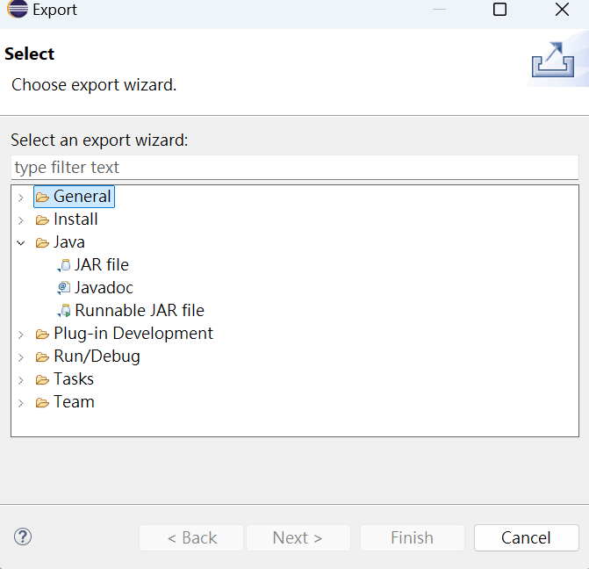
Jar , javaDoc
JAR file
JavaDoc
/**
*/
@version
@author
@param

Slide 4
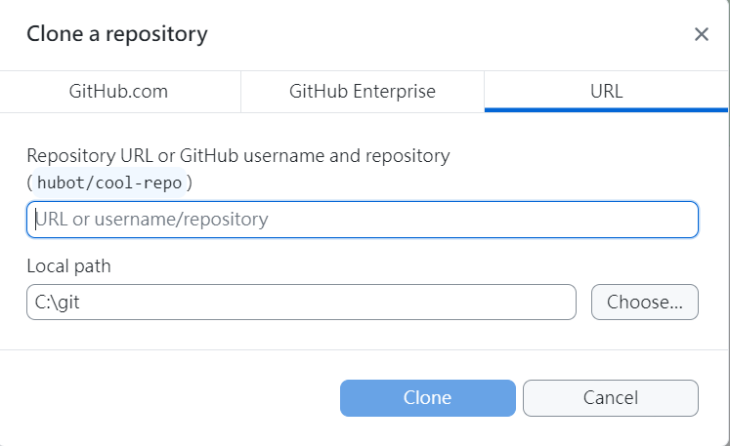
GitHub
本地端主機
新增資料夾
GitHub網站
New
Create a new repository
Repository name
Description
Add readme file
GitHub desktop
Clone a repository
URL

Slide 5
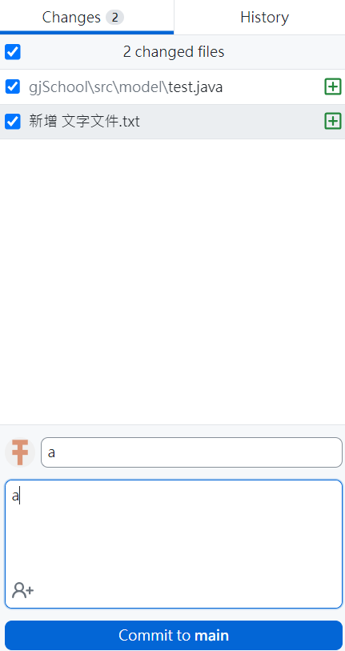

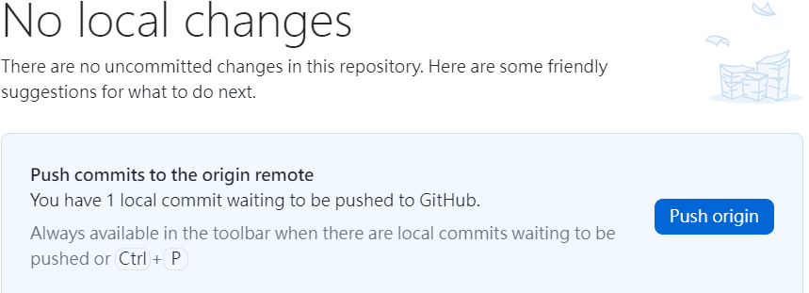
Git hub DeskTop

